Slide 1

Disaster Relief Management System
A Web-Based System for Disaster Reporting and Relief Coordination

Slide 2

Introduction: Bridging the Gap in Crisis Response
Natural and man-made disasters unleash devastating consequences, demanding immediate and precise action. Our system leverages technology to enhance disaster management, ensuring aid reaches those in need swiftly and effectively.
The Urgency of Response
Technology as a Catalyst
Rapid, coordinated action is paramount in mitigating the impact of crises and saving lives.
Harnessing digital tools dramatically improves the efficiency and reach of disaster relief operations.

Slide 3

Addressing Critical Challenges in Disaster Relief
Current disaster management often suffers from systemic inefficiencies. Our solution directly targets these pain points to create a more effective and transparent response framework.
1
2
Delayed Reporting
Poor Coordination
Slow communication of initial disaster impacts hinders timely intervention and resource allocation.
Fragmented efforts among aid organizations and government agencies lead to redundancy and gaps in service.
3
4
Lack of Donation Transparency
Inefficient Distribution
Unclear tracking of contributions erodes public trust and accountability.
Logistical bottlenecks prevent essential relief supplies from reaching affected populations quickly.

Slide 4

Project Objectives: Enhancing Every Stage of Relief
Our system is meticulously designed to optimize the entire disaster relief lifecycle, from initial notification to comprehensive aid delivery.
Expedited Disaster Reporting
1
Enable real-time incident updates for faster situational awareness and emergency activation.
Streamlined Relief Coordination
2
Facilitate seamless collaboration among all stakeholders, optimizing resource deployment.
Transparent Donation Management
3
Provide clear, auditable records of all donations, fostering trust and accountability.
Empowered Decision-Making
4
Offer data-driven insights to guide strategic planning and operational adjustments during crises.

Slide 5
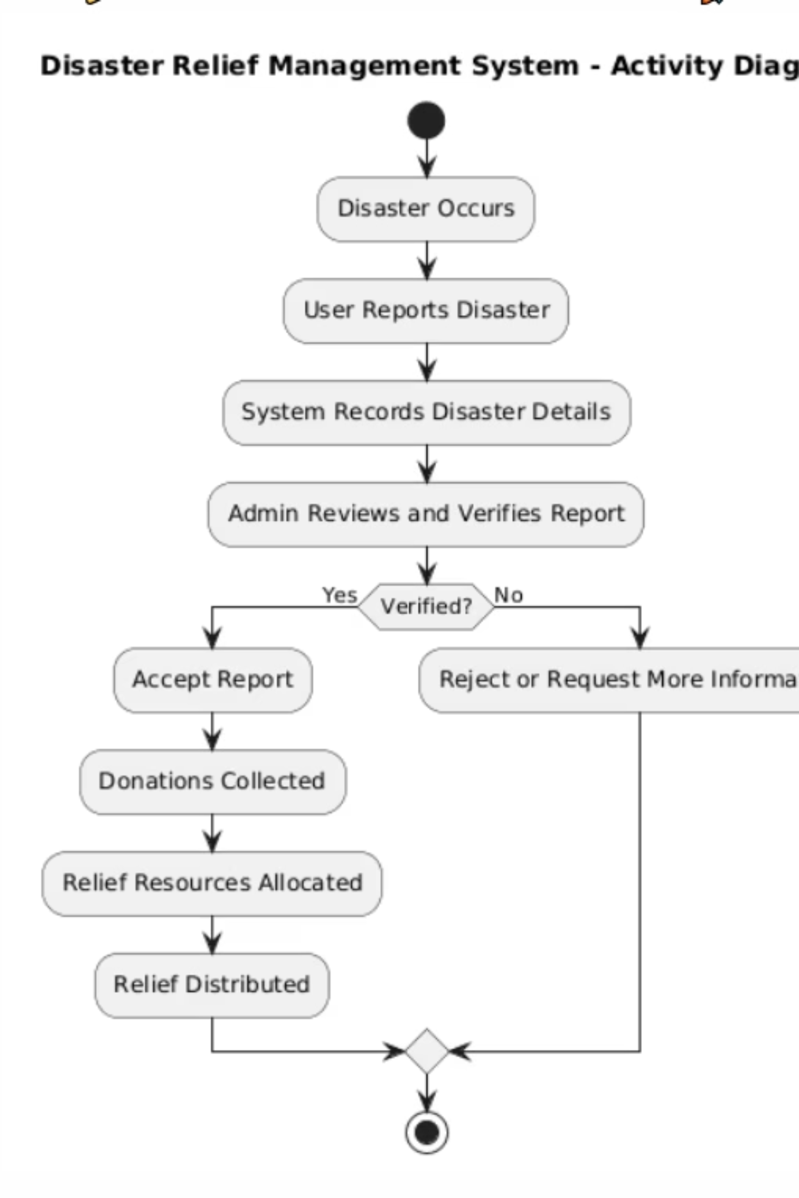
Activity Diagram:
This activity diagram illustrates the sequential flow and decision points within the disaster relief management system, providing a clear visual of its operational logic.
From incident reporting to resource allocation, each step is designed for clarity and efficiency.

Slide 6
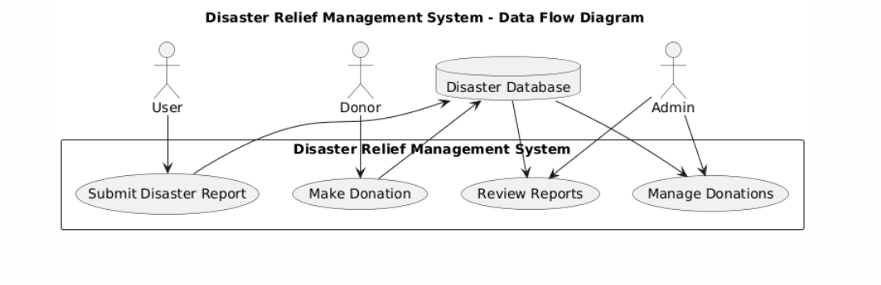
Data Flow Diagram: Understanding System Interactions

Slide 7
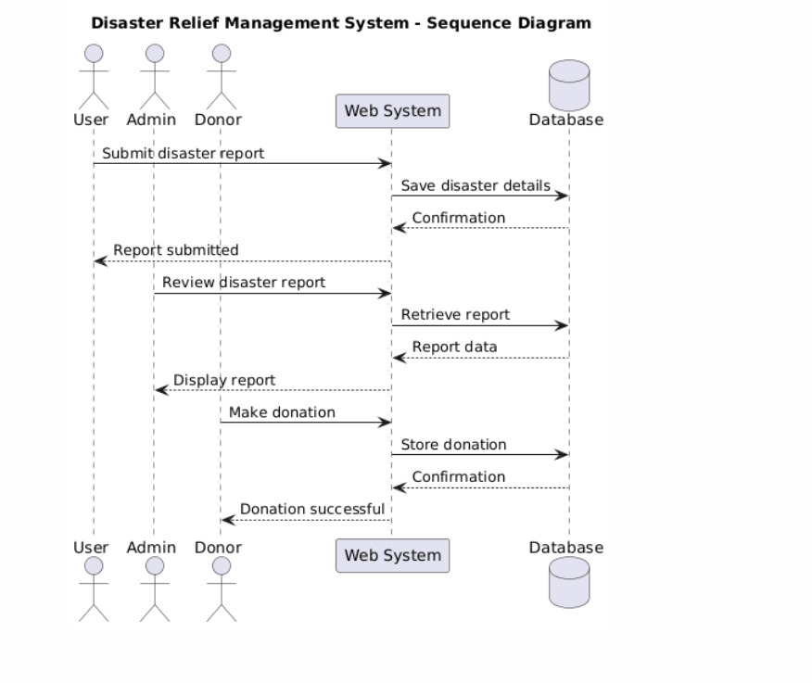
Sequence Diagram: Detailing System Processes

Slide 8

Conclusion: A New Era of Disaster Preparedness
Our web-based disaster relief management system offers a powerful solution to the complex challenges of emergency response, providing a framework for quicker, more transparent, and highly coordinated actions.
Key Benefits
Significantly reduces response times
Enhances transparency in all operations
Fosters greater collaboration among relief efforts
Future Enhancements
Integration of advanced mobile reporting features
Incorporation of GIS for precise location tracking and mapping
AI-driven predictive analytics for proactive response
With continuous development, this system will become an indispensable tool in safeguarding communities worldwide.

